Slide 1
Advancing the Chemical Sciences through Deep Learning
Garrett B. Goh
Data Scientist (Pauling Fellow)
Advanced Computing, Mathematics & Data Division, PNNL

Slide 2

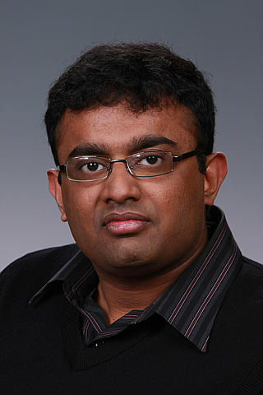
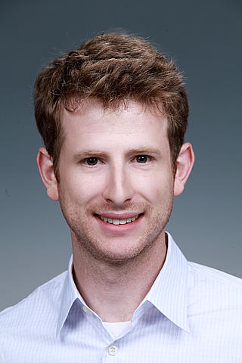

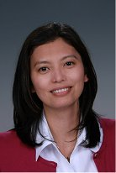




Acknowledgements
Past & Current Collaborators
Funding Resources
Charles Siegel
PNNL
Nathan Hodas
PNNL
Mariefel Olarte
PNNL
Abhinav Vishnu
PNNL
Nathan Baker
PNNL
Jim Pfaendtner
UW

Slide 3
Overview
Deep Learning 101
Recent Trends in Deep Learning
Deep Learning and Chemistry
Learning Directly From Data
Integrating Domain Knowledge into Training Data
Towards Interpretation of Deep Neural Networks
Towards a “Smarter” Neural Network “Chemist”
Towards Molecular Generation
Conclusion & Future Outlook

Slide 4
Deep Learning 101

Slide 5




What is Deep Learning?
Traditional Machine Learning:
Linear Regression
Logistic Regression
Support-Vector Machine
Random Forest
Machine Learning
Deep Learning

Slide 6
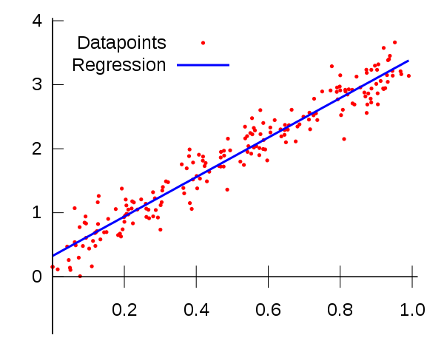
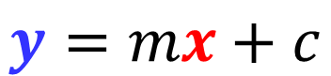
From Linear Regression to Deep Learning
$$y=mx+c$$
Output
(Prediction)
Input
(Features)

Slide 7
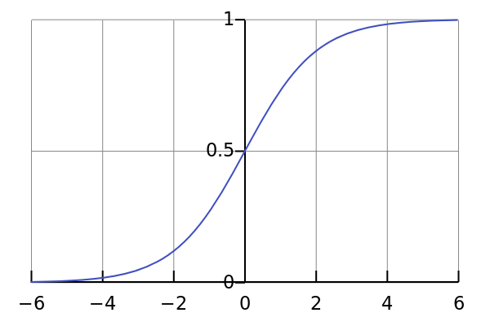
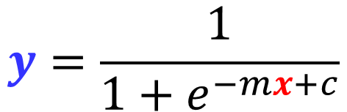
From Linear Regression to Deep Learning
$$y=\frac{1}{1+e^{−mx+c}}$$
Output
(Prediction)
Input
(Features)

Slide 8
From Linear Regression to Deep Learning
Input
(Features)
Output
(Prediction)

Slide 9
From Linear Regression to Deep Learning
Many Hidden Layers
Input
(Features)
Output
(Prediction)
Multi-Layer Perceptron (MLP) Neural Network

Slide 10
Recent Trends in Deep Learning

Slide 11
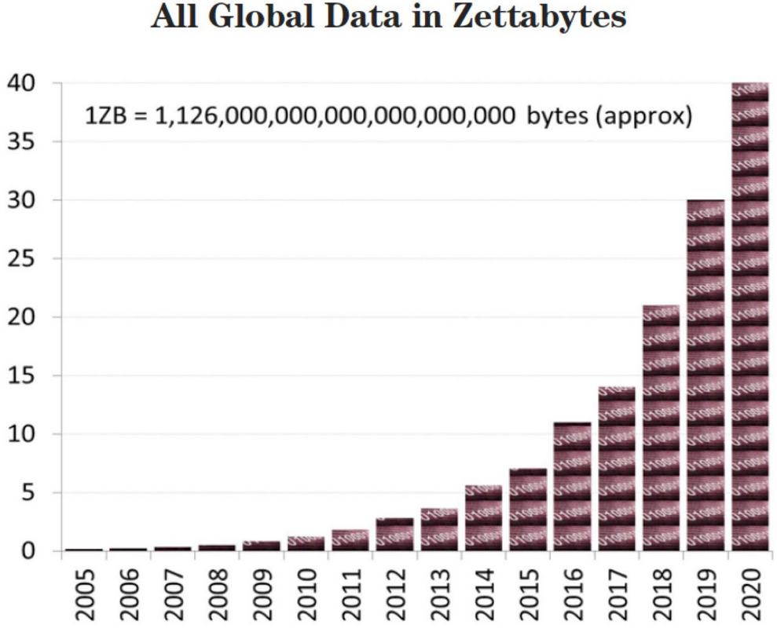
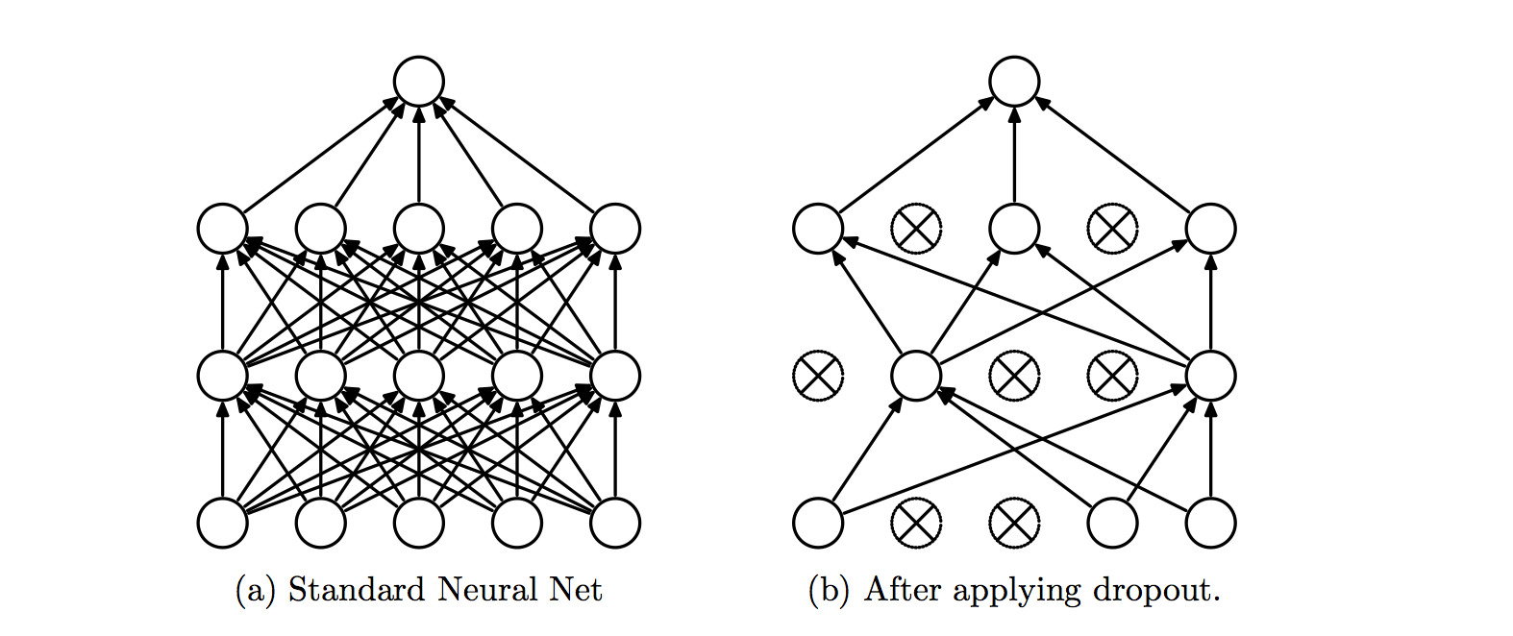
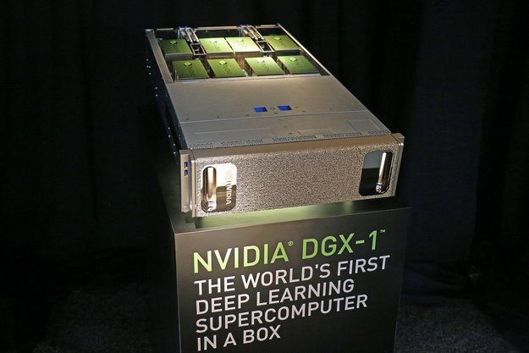
Why Deep Learning Today?
Data
Algorithms for training deep neural networks
Hardware acceleration to enable deep learning at reasonable cost
Glorot, X.; Bordes, A.; Bengio, Y. Proc. of the 14th Int. Conf. on Artificial Intelligence and Statistics 2011
Srivastava, N.; Hinton, G.; Krizhevsky, A.; Sutskever, I.; Salakhutdinov, R. J. Mach. Learn Res. 2014, 15, 1929

Slide 12
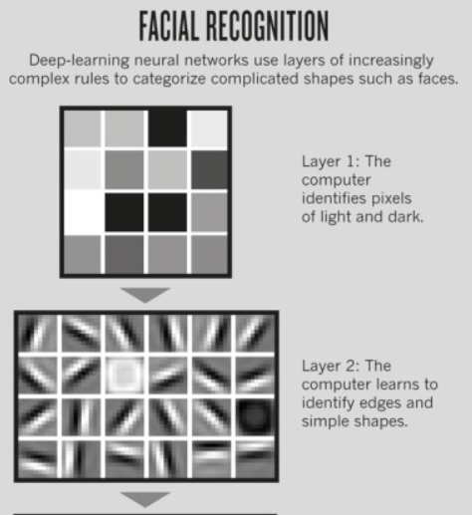
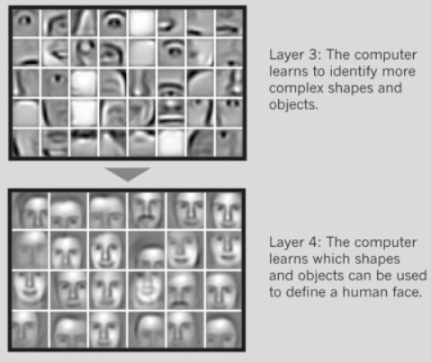
What makes Deep Learning better than other Machine Learning algorithms?
Representation Learning → Automated Feature Engineering
http://www.nature.com/news/computer-science-the-learning-machines-1.14481

Slide 13

What makes Deep Learning better than other Machine Learning algorithms?
Programming Paradigm vs Learning Paradigm
http://www.nature.com/news/computer-science-the-learning-machines-1.14481

Slide 14
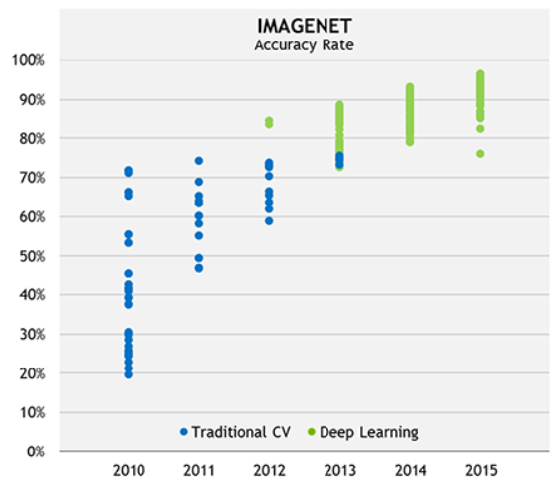
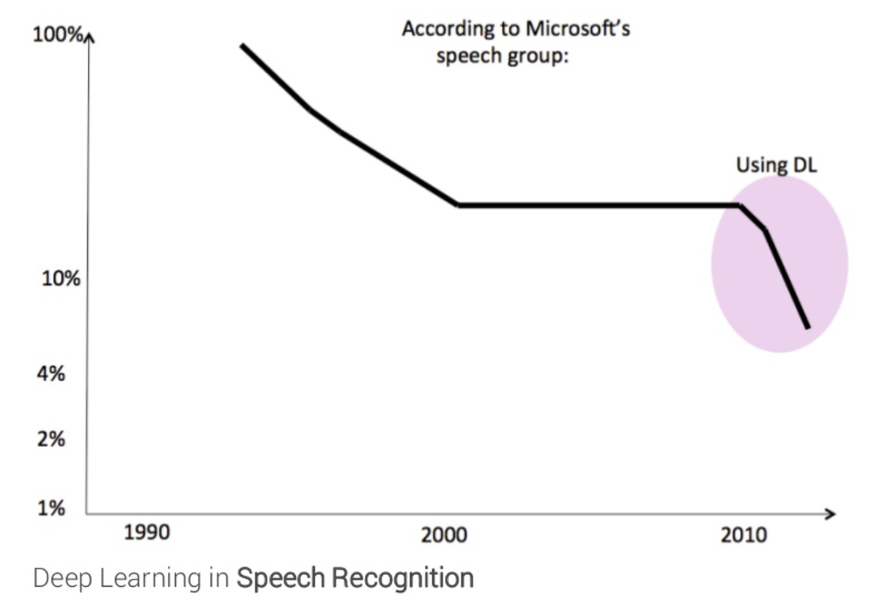
Documented Deep Learning Success in Tech
Human-level performance in image classification and speech recognition within ~3 years
Manual feature engineering in these fields has been replaced by deep neural networks
https://blogs.nvidia.com/blog/2016/01/12/accelerating-ai-artificial-intelligence-gpus/
https://www.slideshare.net/LuMa921/deep-learning-a-visual-introduction

Slide 15
Deep Learning & Chemistry

Slide 16
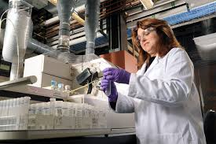
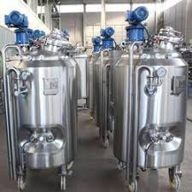

Key Goals in R&D in the Chemical Sciences
Goal #1
Designing chemicals with the desired properties
Goal #2
Producing designed chemicals at scale
Design
Production
Product
~ Years to Decades

Slide 17
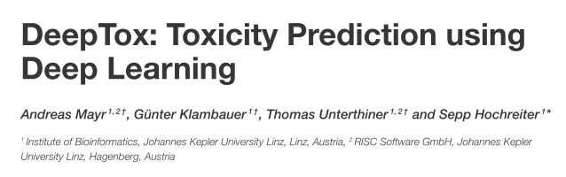
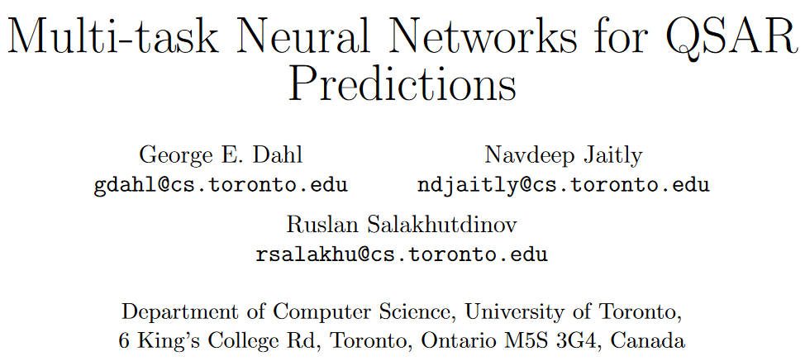
Recent Advances in Deep Learning in Chemistry
Deep Learning trained on molecular descriptors were the top performing models in:
Merck Kaggle challenge in 2012 (activity prediction)
Tox21 challenge in 2014
The winning teams in both challenges were from the computer science department (not chemistry!)
Mayr, A.; Klambauer, G.; Unterthiner, T.; Hochreiter, S. Front. Env. Sci. 2016, 3, 1.
Dahl, G. E.; Jaitly, N.; Salakhutdinov, R. 2014 https://arxiv.org/abs/1406.1231

Slide 18
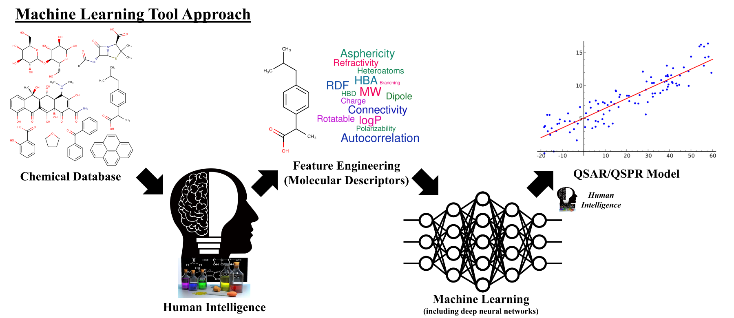
Conventional Approach to Using Deep Learning in Chemistry

Slide 19
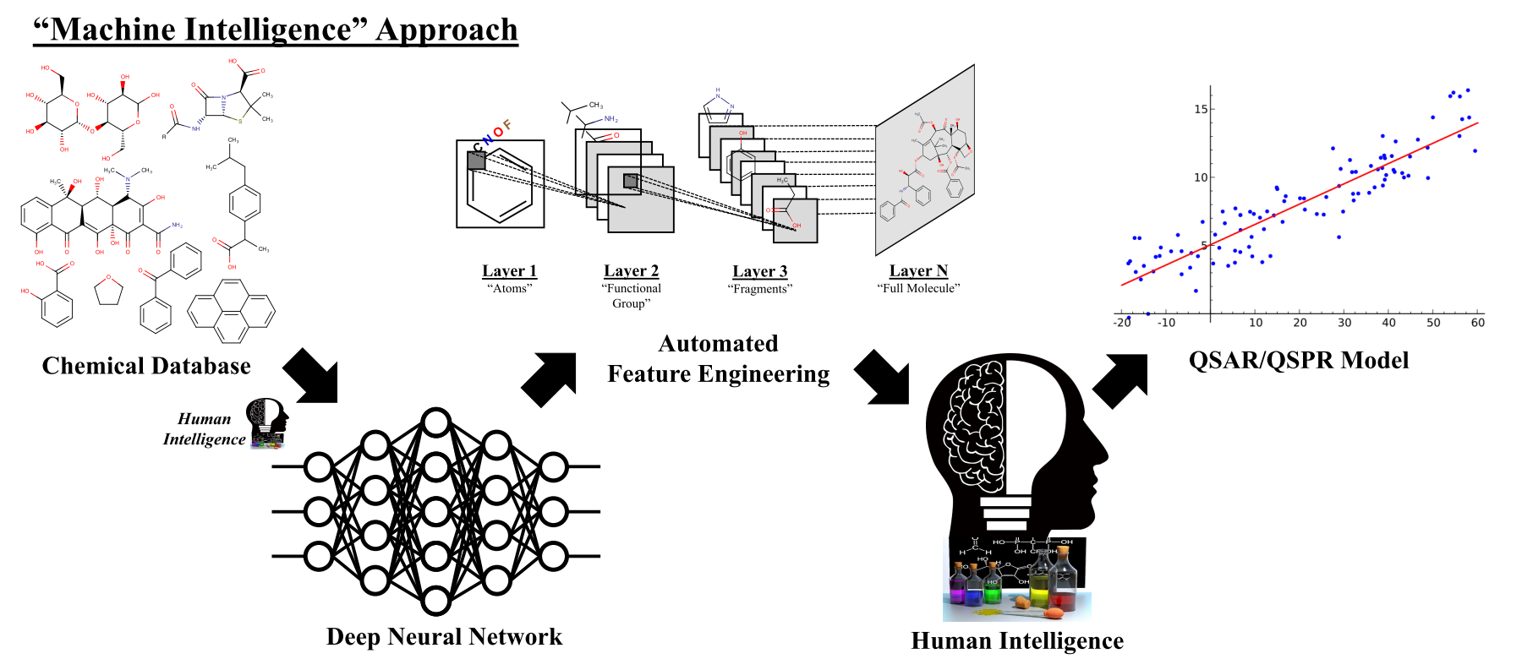
Our Approach to Using Deep Learning in Chemistry

Slide 20
Learning Directly From Data

Slide 21



Deep Learning Models Predict Many Properties
Deep Learning
Physical
Solvation Energy (500 cpds)
Solubility (1k cpds)
Biochemical
Activity (10k cpds)
Biodegradability (1k cpds)
Physiological
Toxicity (10k cpds)

Slide 22
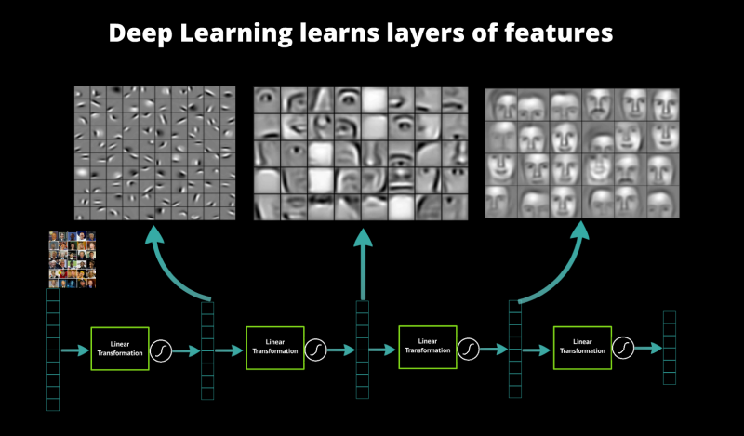
Introduction to Convolutional Neural Networks (CNN)

Slide 23
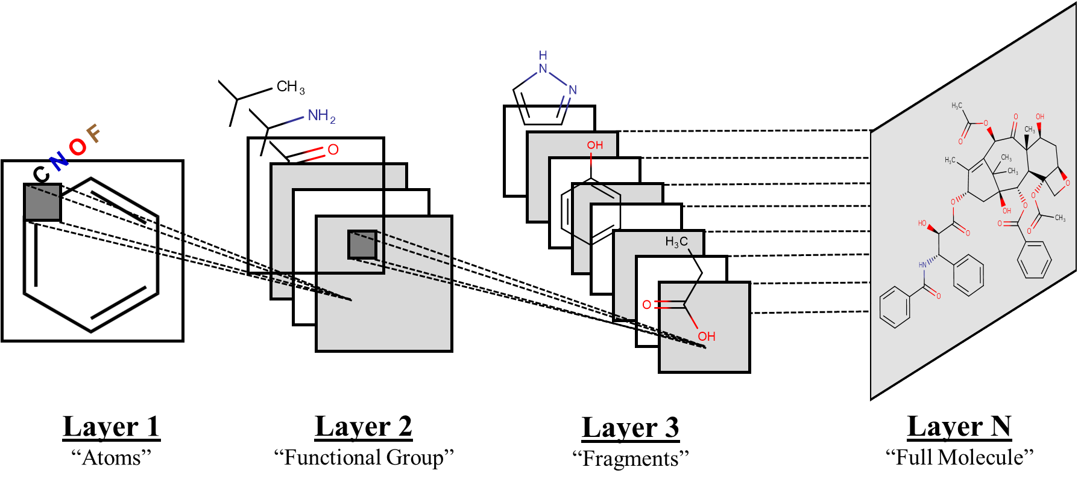
Introduction to Convolutional Neural Networks (CNN)
An analogous deep neural network trained on molecular diagram drawings would learn chemistry features
Goh, G.B.;* Siegel, C.; Vishnu, A.; Hodas, N.O.; Baker, N.A. 2017
https://arxiv.org/abs/1706.06689 (in review J. Chem. Inf. Model.)

Slide 24
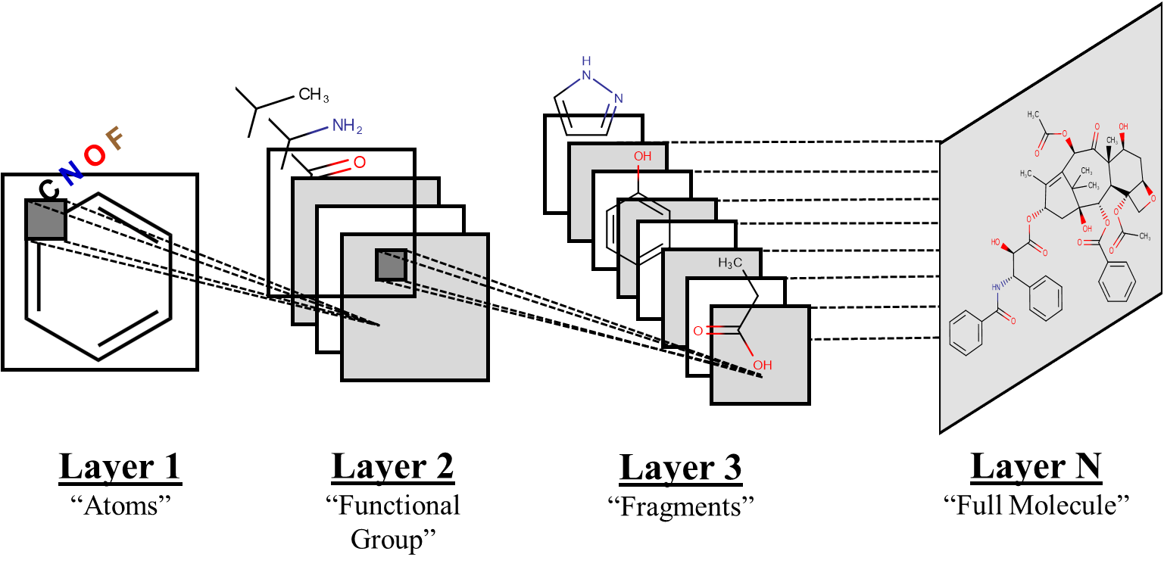
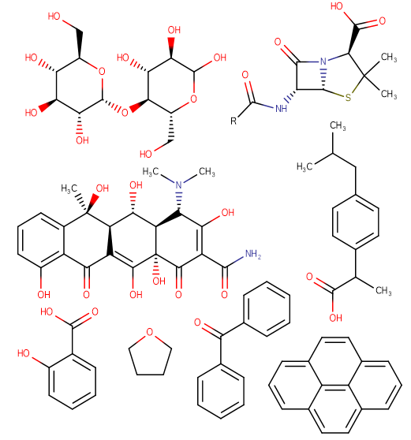
Chemception: Learning Directly from Image Data to Predict Diverse Properties
Chemical Inception (Chemception)
First CNN model for broad & generalizable chemical property prediction
“Universal” network design of ~50 layers, ~100,000 parameters is effective for predicting multiple chemical properties
Minimal feature engineering required (i.e. molecular descriptors, in-depth fundamentals)
Physiological
e.g. Toxicity
Biochemical
e.g. Activity
Physical
e.g. Solvation
Chemical
Drawings
Chemception
Goh, G.B.;* Siegel, C.; Vishnu, A.; Hodas, N.O.; Baker, N.A. 2017
https://arxiv.org/abs/1706.06689 (in review J. Chem. Inf. Model.)

Slide 25
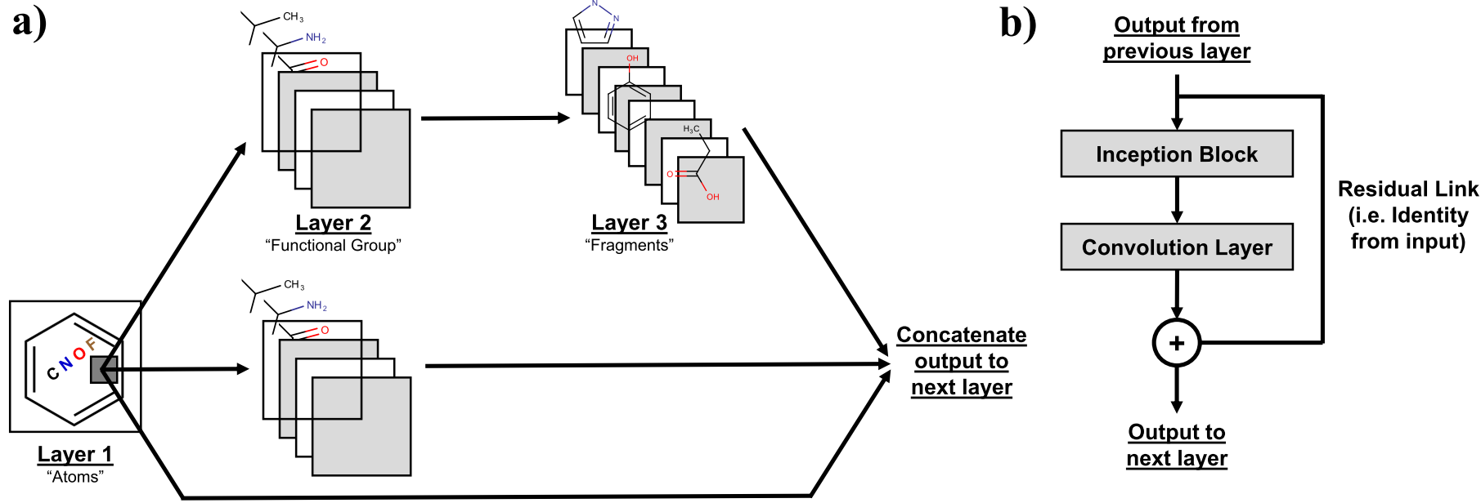
Chemception: Learning Directly from Image Data to Predict Diverse Properties
Chemical Inception (Chemception)
First CNN model for broad & generalizable chemical property prediction
“Universal” network design of ~50 layers, ~100,000 parameters is effective for predicting multiple chemical properties
Minimal feature engineering required (i.e. molecular descriptors, in-depth fundamentals)
Inception Modules
Residual Training
Goh, G.B.;* Siegel, C.; Vishnu, A.; Hodas, N.O.; Baker, N.A. 2017
https://arxiv.org/abs/1706.06689 (in review J. Chem. Inf. Model.)

Slide 26
Using “unsophisticated” raw data is a viable strategy
Goh, G.B.;* Siegel, C.; Vishnu, A.; Hodas, N.O.; Baker, N.A. 2017
https://arxiv.org/abs/1706.06689 (in review J. Chem. Inf. Model.)

Slide 27
Using “unsophisticated” raw data is a viable strategy
Goh, G.B.;* Siegel, C.; Vishnu, A.; Hodas, N.O.; Baker, N.A. 2017
https://arxiv.org/abs/1706.06689 (in review J. Chem. Inf. Model.)

Slide 28
Using “unsophisticated” raw data is a viable strategy
Goh, G.B.;* Siegel, C.; Vishnu, A.; Hodas, N.O.; Baker, N.A. 2017
https://arxiv.org/abs/1706.06689 (in review J. Chem. Inf. Model.)

Slide 29
Integrating Domain Knowledge into Training Data

Slide 30
Issues with Chemical Data: One Leg of the Tripod is Missing
Data
Algorithms for training deep neural networks
Hardware acceleration to enable deep learning at reasonable cost
Need More!
Glorot, X.; Bordes, A.; Bengio, Y. Proc. of the 14th Int. Conf. on Artificial Intelligence and Statistics 2011
Srivastava, N.; Hinton, G.; Krizhevsky, A.; Sutskever, I.; Salakhutdinov, R. J. Mach. Learn Res. 2014, 15, 1929

Slide 31
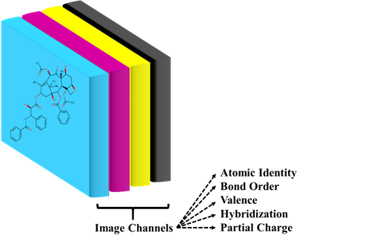
Augmented Chemception: Improving Performance with Local Annotations
High quality labeled data is expensive & limited in the sciences
From Greyscale to Color Augmented Images:
Encoded basic chemical information into image channels
Goh, G.B.;* Siegel, C.; Vishnu, A.; Hodas, N.O.; Baker, N.A. 2017
https://arxiv.org/abs/1710.02238 (published in WACV 2018)
31

Slide 32
Neural Networks use Local Annotations to Develop Better Representations
Goh, G.B.;* Siegel, C.; Vishnu, A.; Hodas, N.O.; Baker, N.A. 2017
https://arxiv.org/abs/1710.02238 (published in WACV 2018)

Slide 33
Neural Networks use Local Annotations to Develop Better Representations
Goh, G.B.;* Siegel, C.; Vishnu, A.; Hodas, N.O.; Baker, N.A. 2017
https://arxiv.org/abs/1710.02238 (published in WACV 2018)

Slide 34
Neural Networks use Local Annotations to Develop Better Representations
Goh, G.B.;* Siegel, C.; Vishnu, A.; Hodas, N.O.; Baker, N.A. 2017
https://arxiv.org/abs/1710.02238 (published in WACV 2018)

Slide 35
Towards Interpretation of Deep Neural Networks

Slide 36
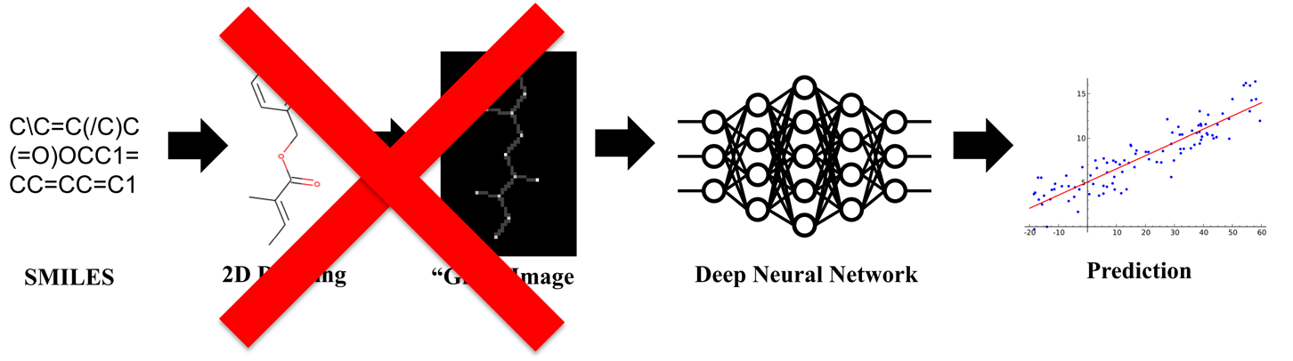
SMILES2vec: Learning Directly from Text Data to Predict Diverse Properties
Embedded structural information in SMILES can be potentially learned and exploited by neural networks
Goh, G.B.;* Hodas, N.O.; Siegel, C.; Vishnu, A. 2017
https://arxiv.org/abs/1712.02034 (in review IEEE Big Data 2018)

Slide 37
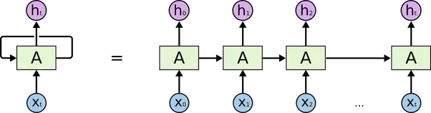
SMILES2vec: Learning Directly from Text Data to Predict Diverse Properties
SMILES2vec
First RNN model for broad & generalizable chemical property prediction
“Universal” network design of ~5 layers, ~100,000 parameters is effective for predicting multiple chemical properties
No feature engineering required
Physiological
e.g. Toxicity
Biochemical
e.g. Activity
C\C=C(/C)C
(=O)OCC1=
CC=CC=C1
Physical
e.g. Solvation
SMILES
“Chemical Text”
SMILES2vec
Goh, G.B.;* Hodas, N.O.; Siegel, C.; Vishnu, A. 2017
https://arxiv.org/abs/1712.02034 (in review IEEE Big Data 2018)

Slide 38
A Chemical Text Representation is as Good as Images
Goh, G.B.;* Hodas, N.O.; Siegel, C.; Vishnu, A. 2017
https://arxiv.org/abs/1712.02034 (in review IEEE Big Data 2018)

Slide 39
A Chemical Text Representation is as Good as Images
Goh, G.B.;* Hodas, N.O.; Siegel, C.; Vishnu, A. 2017
https://arxiv.org/abs/1712.02034 (in review IEEE Big Data 2018)

Slide 40
A Chemical Text Representation is as Good as Images
Goh, G.B.;* Hodas, N.O.; Siegel, C.; Vishnu, A. 2017
https://arxiv.org/abs/1712.02034 (in review IEEE Big Data 2018)

Slide 41
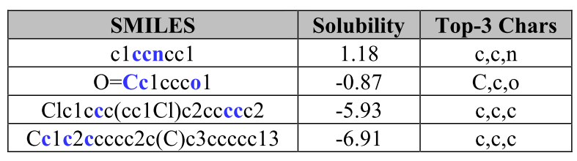
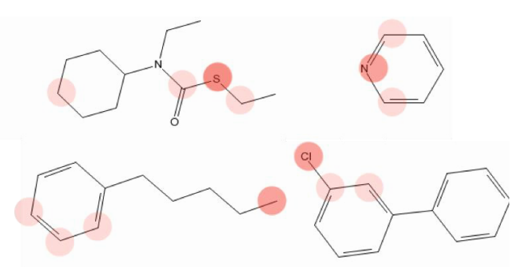
An Interpretable SMILES2vec using a Solubility Dataset Example
SMILES2vec “looks” at characters that correspond to parts of hydrophobic/hydrophilic functional groups with a top-3 accuracy of 88%
Goh, G.B.;* Hodas, N.O.; Siegel, C.; Vishnu, A. 2017
https://arxiv.org/abs/1712.02034 (in review IEEE Big Data 2018)

Slide 42
Training a “Smarter” Neural Network “Chemist”

Slide 43
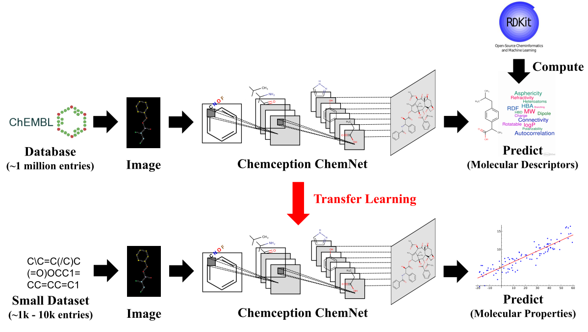
ChemNet: A Pre-Trained(“Taught”) Model using Weak Supervision
Catch 22: Deep learning requires lots of data, but data is expensive
First application of weak supervised learning & transfer learning in the chemical sciences to train ChemNet, a “chemist expert” neural network
Goh, G.B.;* Siegel, C.; Vishnu, A.; Hodas, N.O. 2017
https://arxiv.org/abs/1712.02734 (published in SIGKDDD 2018)

Slide 44
ChemNet: A Pre-Trained(“Taught”) Model using Weak Supervision
Use rule-based models / physics-based simulations to compute labels for large unlabeled databases
Neural network learns representations that are relevant to domain, then transfer learning leverages learned representations to predict unseen chemical tasks
Goh, G.B.;* Siegel, C.; Vishnu, A.; Hodas, N.O. 2017
https://arxiv.org/abs/1712.02734 (published in SIGKDDD 2018)

Slide 45
Plug-and-Play Neural Network for Small Molecule Property Prediction
Goh, G.B.;* Siegel, C.; Vishnu, A.; Hodas, N.O. 2017
https://arxiv.org/abs/1712.02734 (published in SIGKDDD 2018)

Slide 46
Plug-and-Play Neural Network for Small Molecule Property Prediction
Goh, G.B.;* Siegel, C.; Vishnu, A.; Hodas, N.O. 2017
https://arxiv.org/abs/1712.02734 (published in SIGKDDD 2018)

Slide 47
Plug-and-Play Neural Network for Small Molecule Property Prediction
Goh, G.B.;* Siegel, C.; Vishnu, A.; Hodas, N.O. 2017
https://arxiv.org/abs/1712.02734 (published in SIGKDDD 2018)

Slide 48
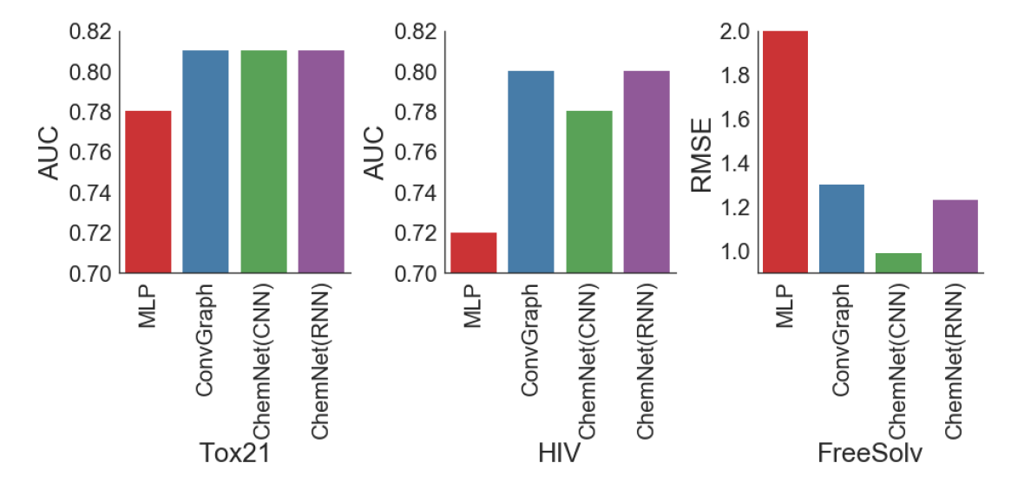
ChemNet-derived Models are state-of-the-art relative to other DL models
Benchmarks (accuracy)
Toxicity (Tox21), Activity (HIV), Free energy of solvation (FreeSolv)
Traditional DL
QSAR/QSPR
Traditional DL
QSAR/QSPR
Traditional DL
QSAR/QSPR
PNNL
PNNL
PNNL
Goh, G.B.;* Siegel, C.; Vishnu, A.; Hodas, N.O. 2017
https://arxiv.org/abs/1712.02734 (published in SIGKDDD 2018)

Slide 49
Towards Molecular Generation

Slide 50
GenChem Can Potentially Identify Compounds
Q. Solving the inverse problem in chemical design & identification?
Current Paradigm
“Let’s screen through 1000+ designs to see if we have the correct chemical with desired properties”
Proposed Paradigm
“Let’s come up with a list of desired properties, and develop algorithms to give us reasonable suggestions of chemicals that fit the profile”
Experiments
Modeling
List of design candidates
Predict properties
Predictor
Experiments
Modeling
List of design requirements
Suggest chemicals
Generator
Goh, G.B.;* Olarte, M.*; et. al. (work in progress)

Slide 51
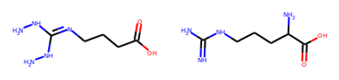
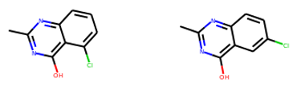
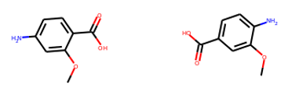
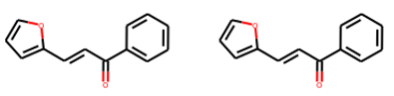
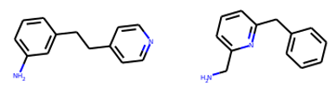
GenChem Can Potentially Identify Compounds
Actual Compound Identity
Suggested Compound Identity
Application to Compound Identification
Incorporated experimental constraints in GenChem model
Accurate suggestions (adhering to constraints specified) can be reasonably achieved for structurally simple low MW compounds
Goh, G.B.;* Olarte, M.*; et. al. (work in progress)

Slide 52
Conclusion & Outlook

Slide 53
Conclusion
Deep Learning enables a Data-Driven Research Paradigm
Chemception and SMILES2vec uses “unsophisticated” image and text representations to make predictions that are as good as conventional ML/DL modeling approaches that rely on sophisticated feature engineering
Interpretable models are the key to bridging the gap between hypothesis-driven research and data-driven research
ChemNet is a transferable universal neural network for small-molecule property prediction, and it consistently outperforms conventional ML/DL approaches in chemistry
Generative models have the potential to address the “inverse problem” in chemical design

Slide 54
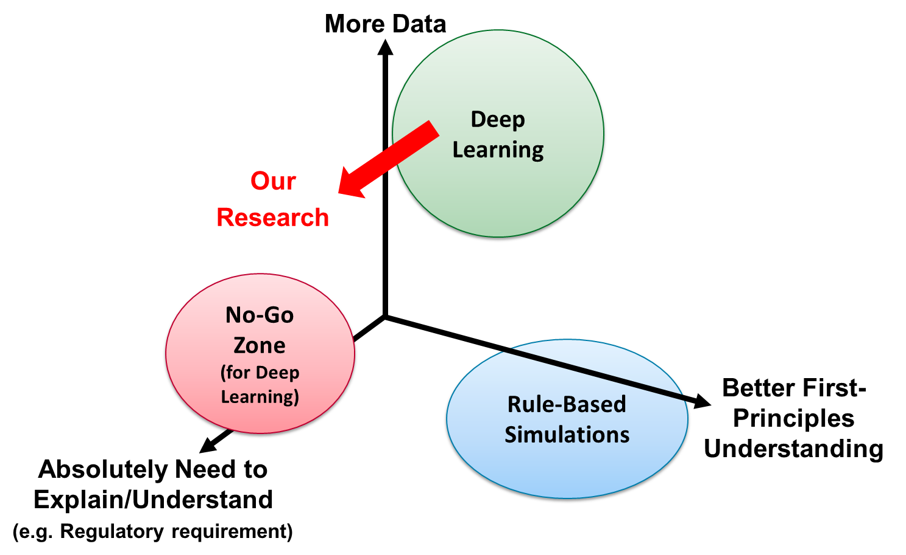
Shifting the Scope of Problems that can be Solved by Deep Learning

Slide 55
Generalizable Takeaways (for other domains)
Help the Neural Network
Exploit domain-expert information to augment the data representation
Integrate Domain Knowledge with the Neural Network
Exploit existing models/tools/simulations developed by domain-expert to generate large labeled synthetic datasets
Knowledge is Hierarchical: Use that to your Advantage
Think about how knowledge was developed in historically, order it hierarchically and explore ways to replicate this process on the neural network
Push the limits of weak supervised learning, transfer learning, learning on related data, etc. may work better than you expect

Slide 56
Questions? garrett.goh@pnnl.gov

